Slide 1


Bioinformatics Summer School
Long-reads Transcriptomics
Fabio Zanarello
CRG, Barcelona, Spain
LongTREC - The Long-reads TRanscriptome European Consortium
Marie Skłodowska-Curie grant agreement No 101072892

Slide 2
Annotation of non-model organisms
1
The Earth Biogenome Project
2
The annotation workflow
3
The Lycaena helle dataset
4
Questions
4

Slide 3
Section 1
The Earth Biogenome Project
Generating the reference genome and annotation of all named eukaryotes

Slide 4
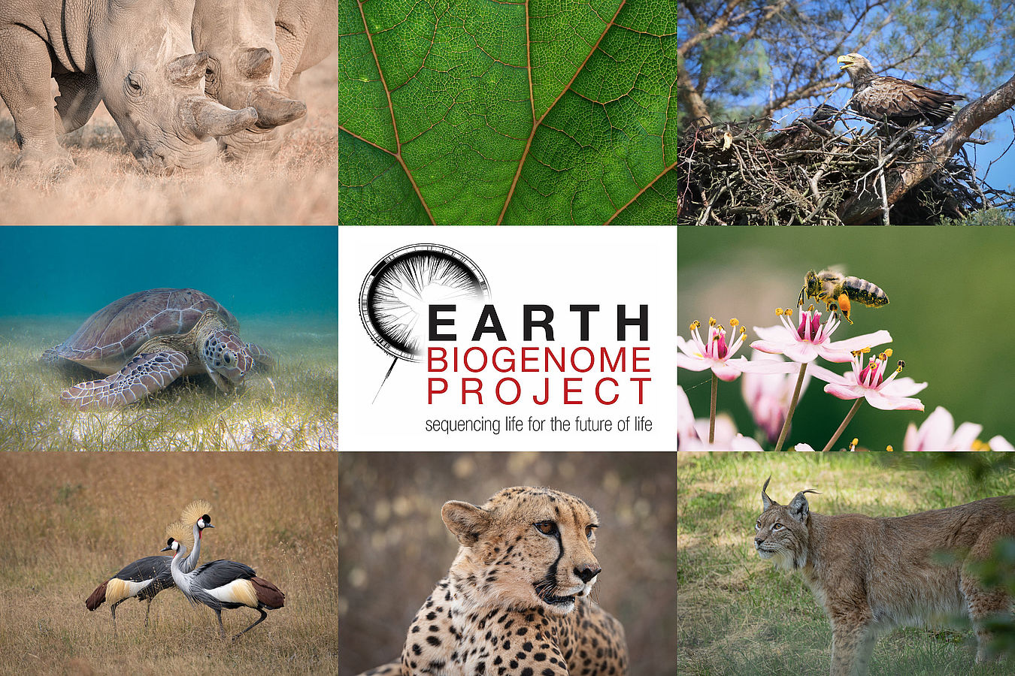
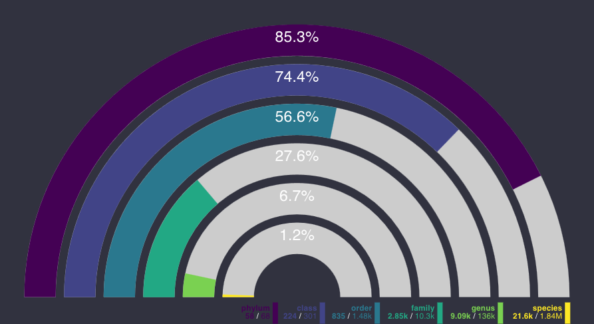
The Earth Biogenome Project
1.8 million names species
10 years
~4.7 billion dollars
Biodiversity and Earth BioGenome Project | (photos: J.Zwilling/O.Krone/unsplash/EBP)
18/06/2025 https://goat.genomehubs.org/

Slide 5
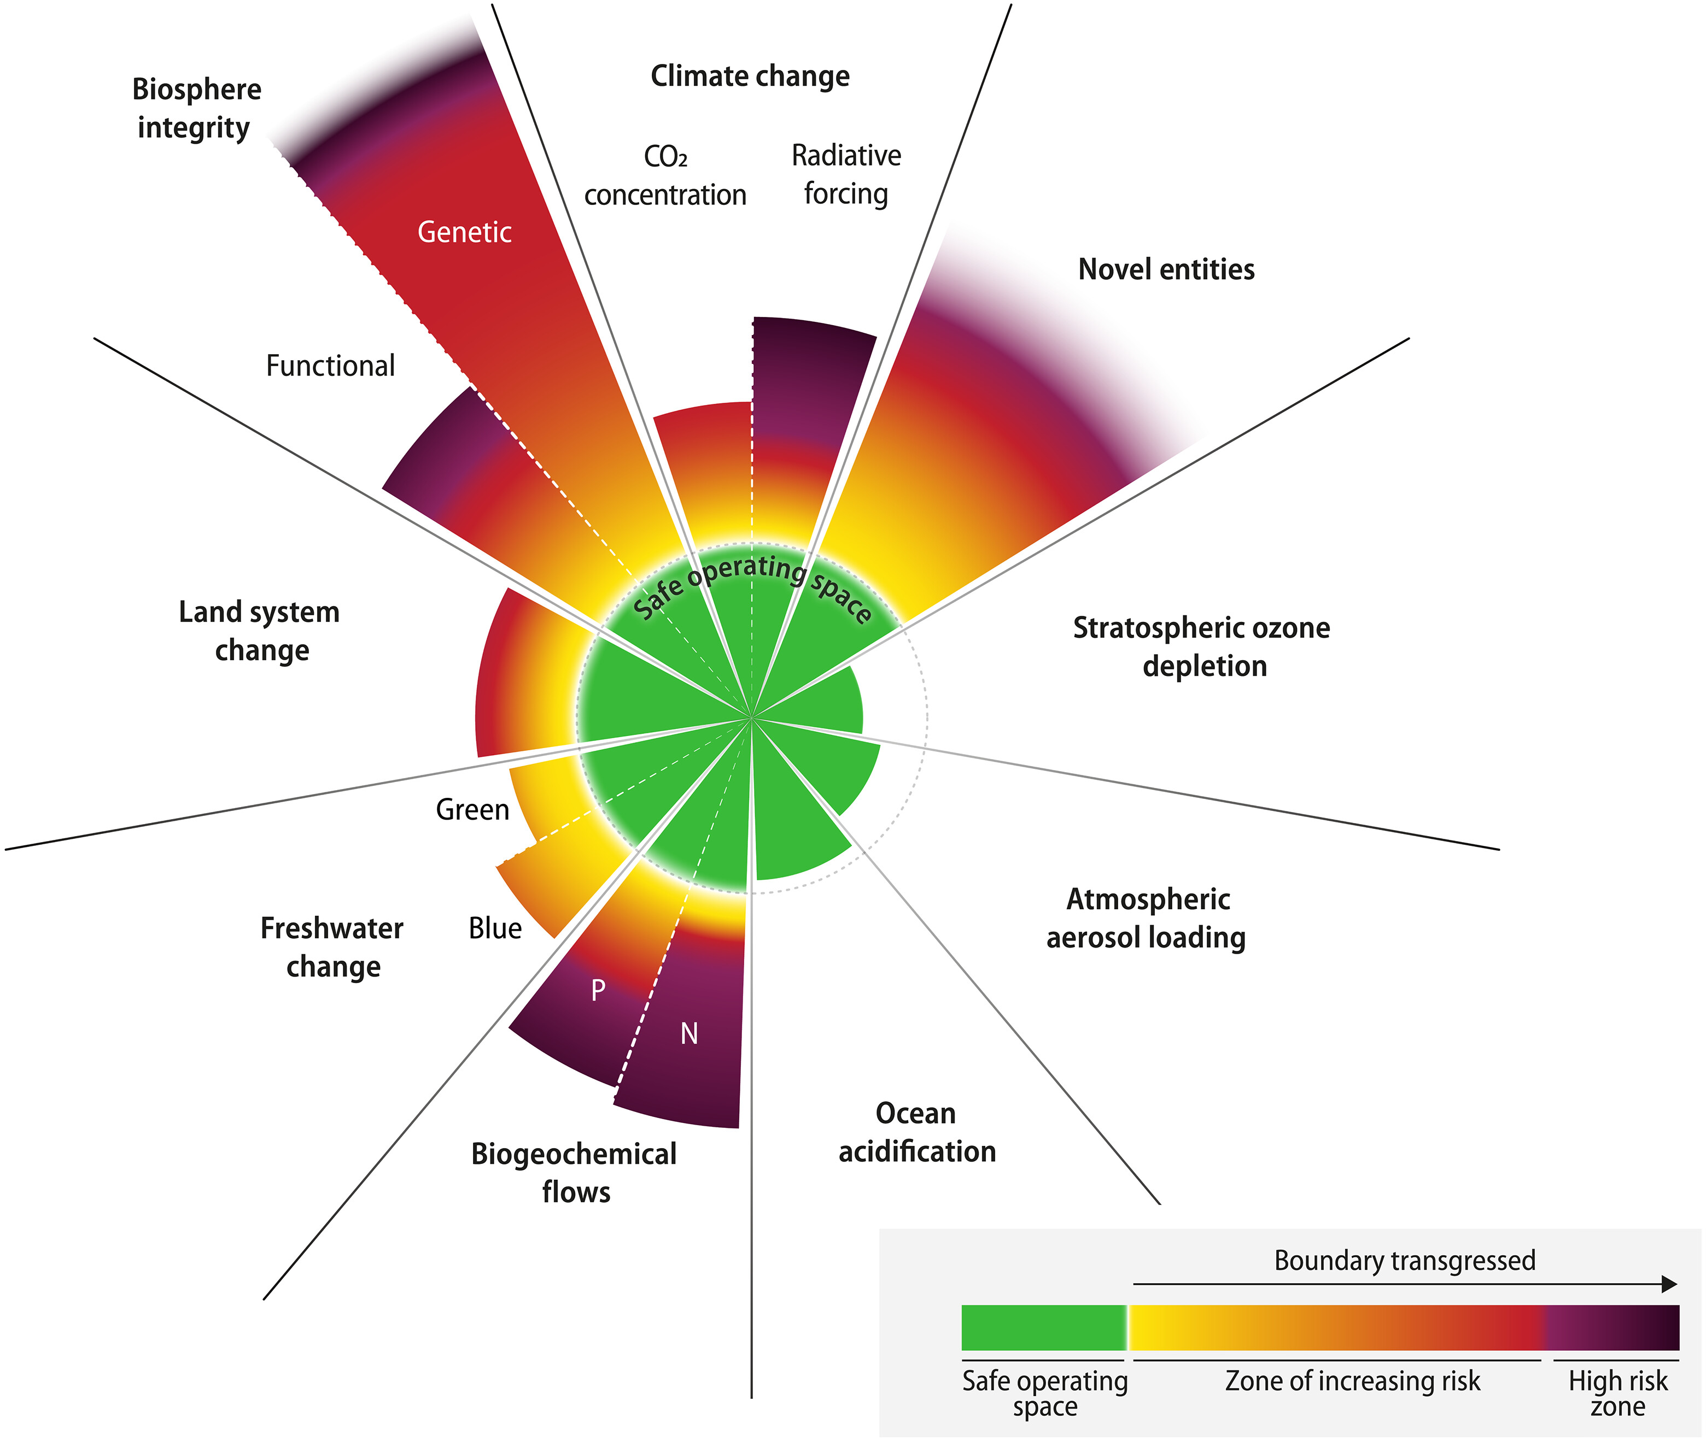
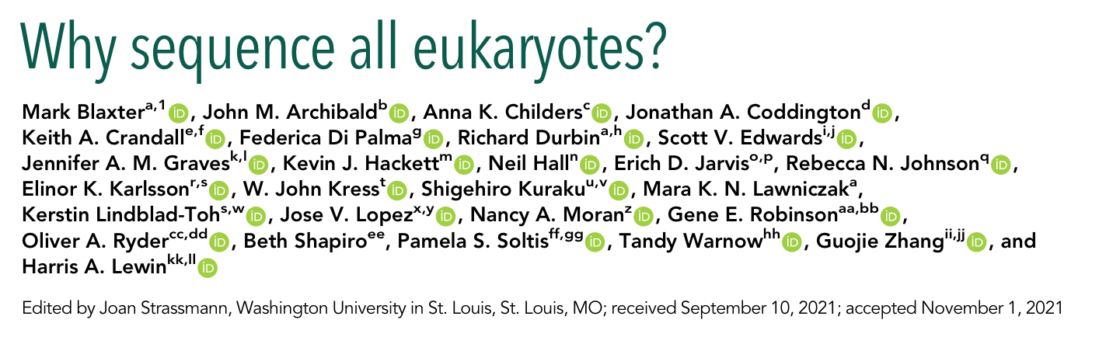
Cataloguing genetic diversity before it disappears
Revealing the Deep Logic of Eukaryotic Gene Regulation
What is the comprehensive list of all eukaryotic genes?
What are the building blocks of eukaryotic genome regulation?
How stable are they?
How do new regulatory regimes arise and supplant existing systems?
Can deep multispecies whole-genome alignments reveal new classes of conserved elements?
What genomic features distinguish conserved regulatory networks?
How do regulatory networks constrain chromosome and genome evolution?
Source: https://www.stockholmresilience.org/research/planetary-boundaries.html

Slide 6
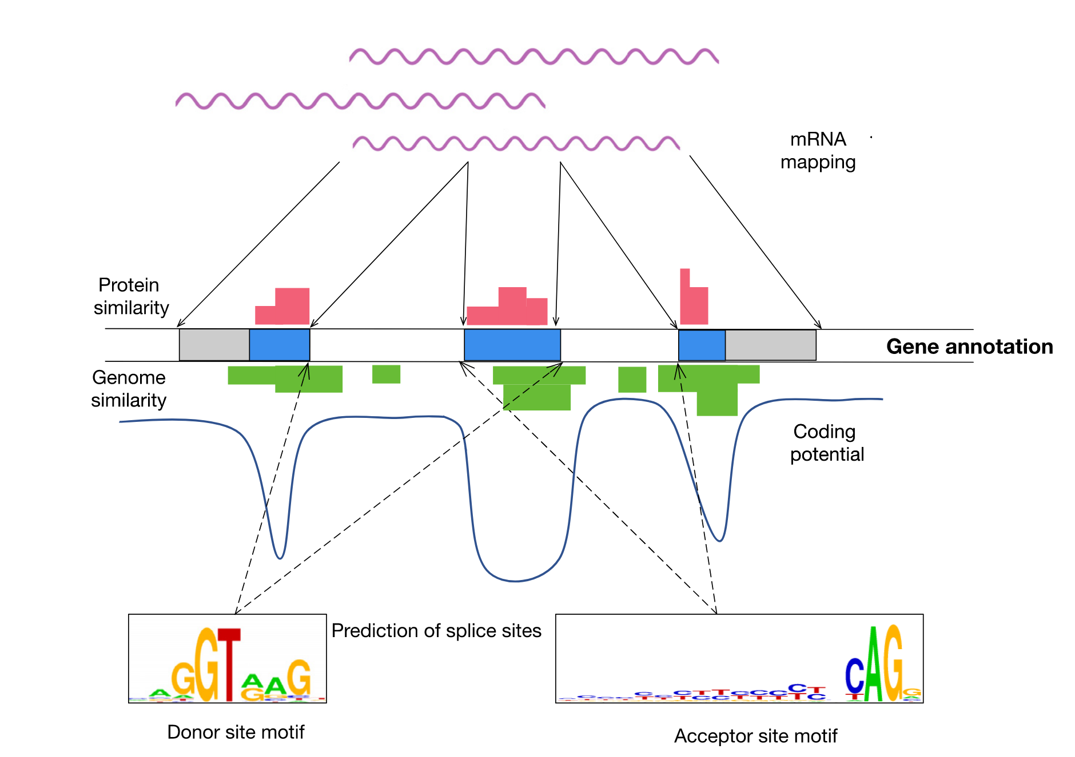
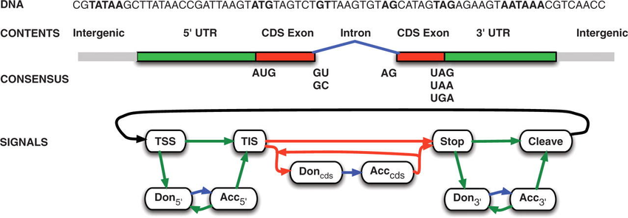
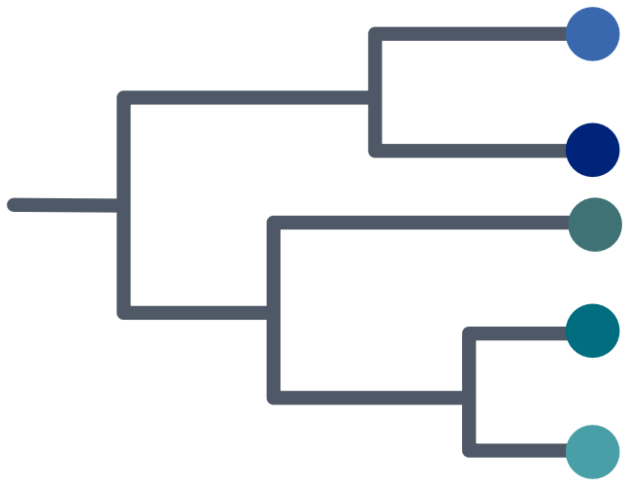
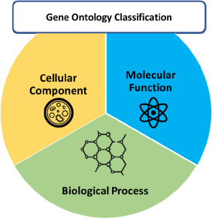
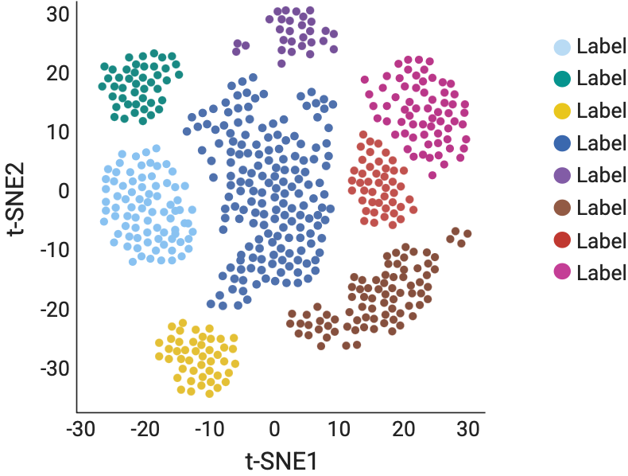
Methods to predict genes in genomic sequences
mRNA sequencing
Sequence similarity
Ab initio methods
?
(some) downstream analysis:
Phylogeny
Functional
annotation
Transcriptome
profiling

Slide 7





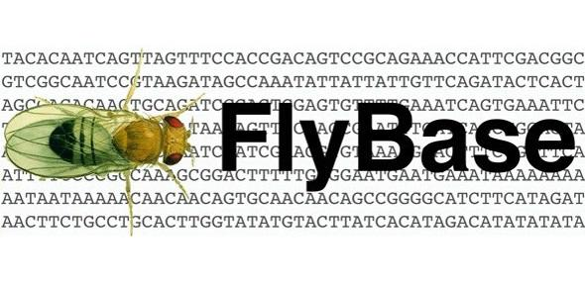
Different scopes for different organisms
MODEL SPECIES
Search for rare isoforms
Focus on non-coding element
Plenty of a priori information
Multiple initiatives and funding
NON-MODEL SPECIES
Biological samples are rare
As general as possible
No a priori knowledge
Little resources available

Slide 8
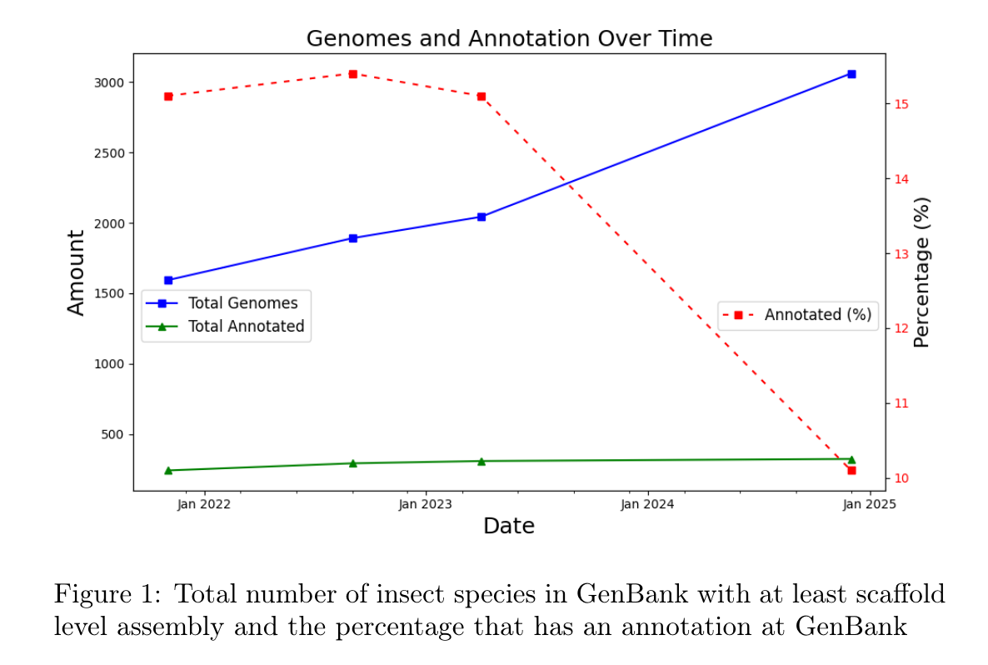
Challenges in scaling genome annotation across the three eukaryotic tree of life
Challenges in scaling genome annotation across the three eukaryotic tree of life
1. Statistical Method Limits
Predict protein-coding genes; omit isoforms and lncRNAs.
Variable accuracy across eukaryotic groups.
2. Evidence Limits (RNA and proteins)
Bias toward “cute, edible and deadly organisms”.
No standards for cross-species non-coding lncRNA annotation.
3. Standards Limits
Lack of unbiased benchmark.
Annotation of 200 Insect Genomes with BRAKER for Consistent Comparisons across Species ,
Stepan Saenko, Katharina J. Hoff, Mario Stanke, bioRxiv 2025.04.17.649312; doi: https://doi.org/10.1101/2025.04.17.649312

Slide 9
Section 2
The annotation workflow
Focus on protein-coding genes and long non-coding RNAs

Slide 10
Integration of multiple evidence is fundamental in non-model organisms
Reference genome
Ab initio genes
Sample
Tissue 1
Tissue 2
Tissue …
Transcribed genes
Genome annotation
RNA
Protein database
Conserved genes
Genome alignments

Slide 11
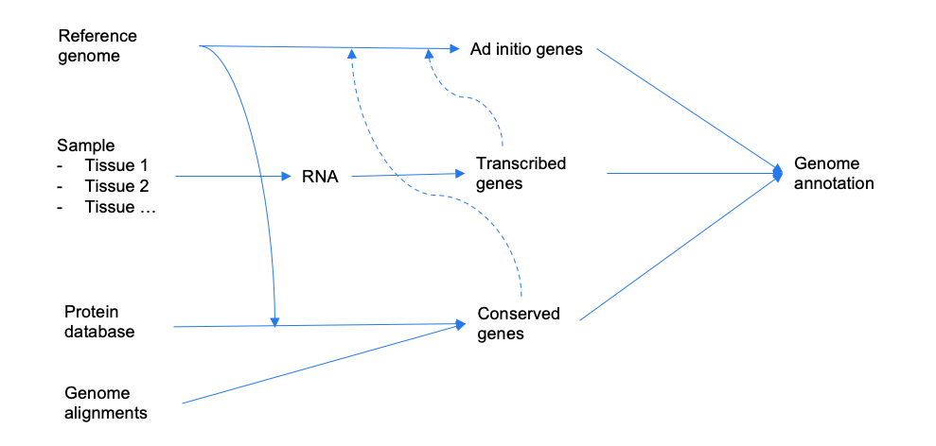
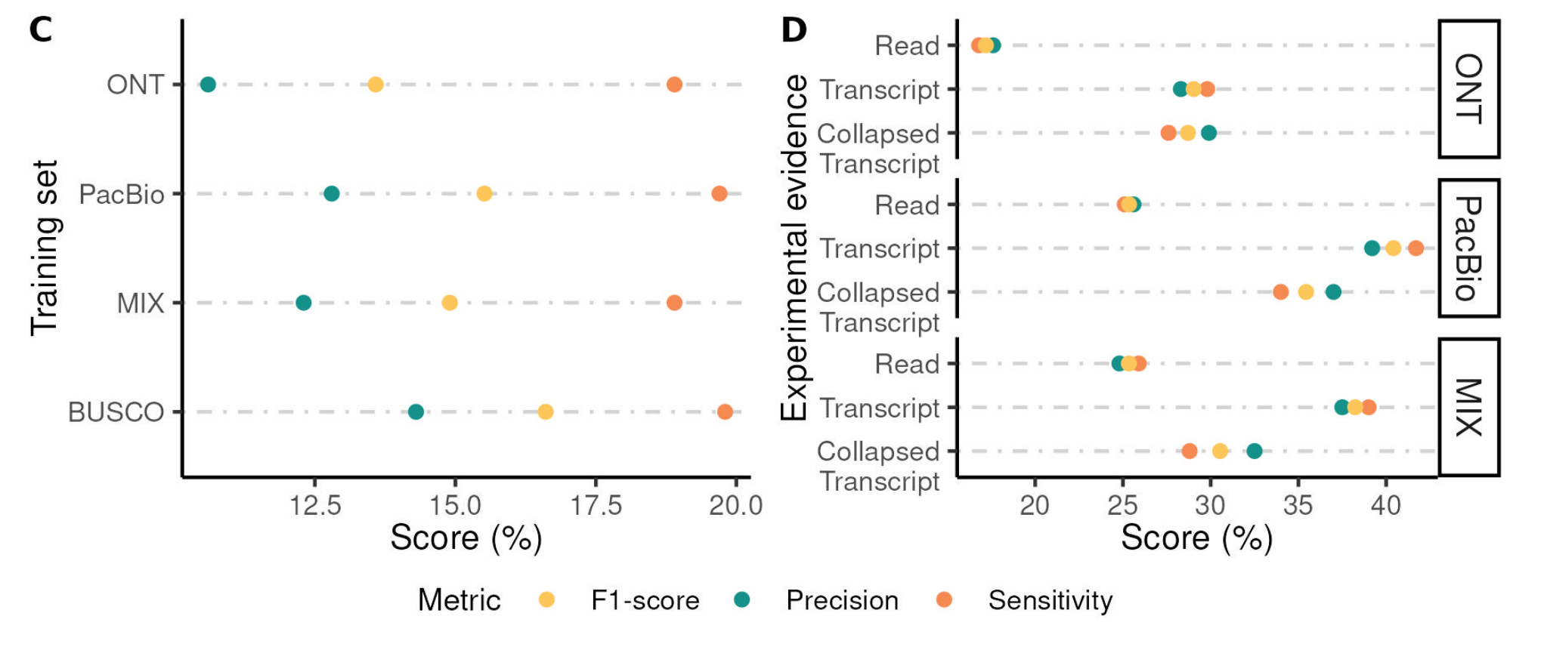
Integration of multiple evidence is fundamental in non-model organisms
Gene prediction with ab-initio methods
Helixer
AUGUSTUS
geneid
GeneMark-ET
Training
Hints
Paniagua, Agustín-García at al. Genome Res. 2025

Slide 12
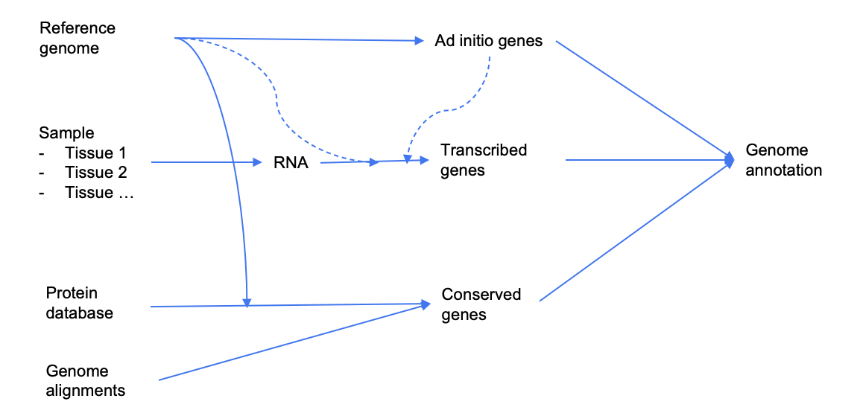
Integration of multiple evidence is fundamental in non-model organisms
Transcript assembly from long-read
IsoQuant
StringTie
FLAIR
Lyric
The LRGASP paper can help with deciding the best method depending on the purpose
Pardo-Palacios, F.J., Wang, D., Reese, F. et al.
Systematic assessment of long-read RNA-seq methods for transcript identification and quantification.
Nat Methods 21, 1349–1363 (2024). https://doi.org/10.1038/s41592-024-02298-3

Slide 13
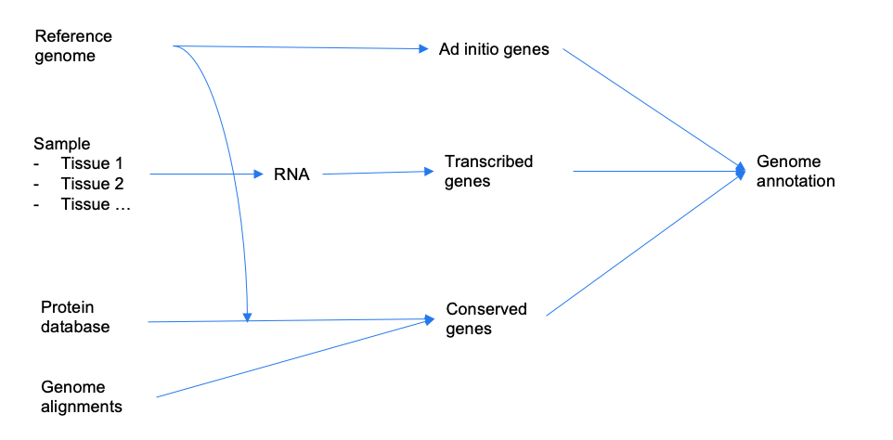
Integration of multiple evidence is fundamental in non-model organisms
Methods to find conserved genes
Miniprot
TOGA
UCSC assembly hub

Slide 14
Integration of multiple evidence is fundamental in non-model organisms
Methods to combine annotations
EVM
AGAT
OMAnnotator

Slide 15
Integration of multiple evidence is fundamental in non-model organisms
Methods to evaluate annotations
BUSCO, OMArk
RNA support
BLAST hits
(Accuracy versus NCBI/Ensembl)
Pipelines
compann-nf (fast comparison)
AnnoAudit (comprehensive report)

Slide 16
Section 3
The Lycena helle dataset
Informing ab initio gene finding with long read RNA seq gene models

Slide 17
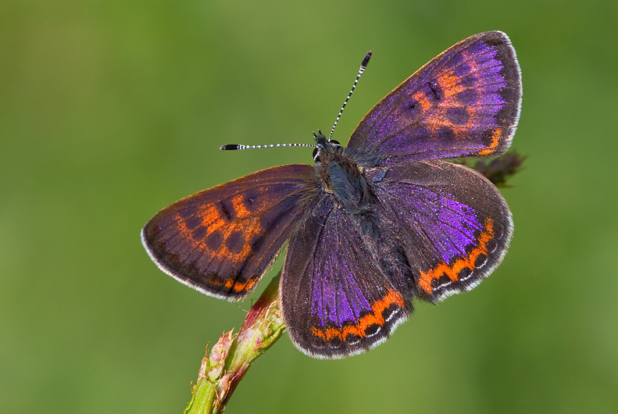

Lycaena helle
Scientific name: Lycaena (Helleia) helle
European status IUCN: Endangered
Most of the population had a fast decline before 1995.
Populations are strongly isolated.
Dispersal ability is limited.
Size: The wingspan is 24–26 mm.
Ecology
It is found from the Pyrenees to northern Norway and from Belgium east across the Palearctic to Central Asia, Siberia and the Amur.
It favours moist meadows, peat bogs, and wetland fallows with Polygonum bistorta
The butterfly flies from May to July, depending on the location

Slide 18
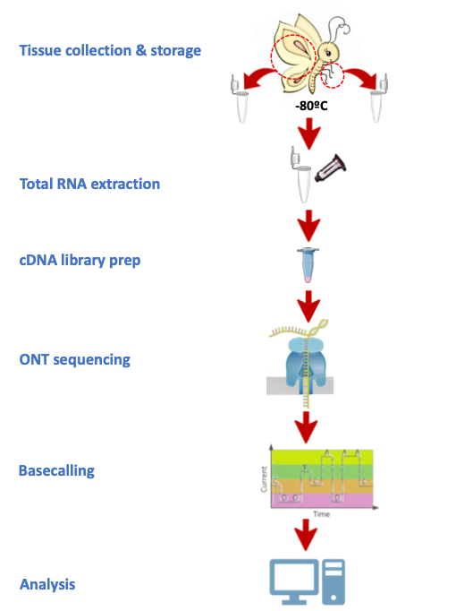
The long-read RNA-seq dataset obtained with ONT
 | Wing
Count | 8.1 M
N50 | 776 bp
Q score | 11.7
 | Leg
Count | 20.7 M
N50 | 1635 bp
Q score | 13.1
Sequencing performed by Silva Carbonel-Sala

Slide 19



Informing geneid with long read derived models
reference assembly
Wing
reads
Material
Reference assembly
Reference annotation
LR datasets (wing, leg)
geneid parameter
Methods
Geneid
Isoquant
minimap2
compann-nf
samtools
bedtools
Experimental approach
Isoquant models
reference assembly
+ geneid
Extract introns
and exons
---------------------------- Annotations --------------------------
simple
introns
exons
introns
+ exons
Evaluate
- compann-nf
- LR support
Leg
reads

Slide 20
Practical session
summer_school/practicals/day2/abinitio_LR/geneid.ipynb

Slide 21
Section 4
Questions

Slide 22
Questions
What are the three main methodologies for annotating genomes?
What is the limiting factors of ab initio predictions?
What are the advantages of using RNA sequencing to annotate genomes?

Slide 23


Thank You!
For more information about the LongTREC Summer School:
https://longtrec.eu

